Slide 1


Revolutionizing Food Delivery with Flutter App

Slide 2


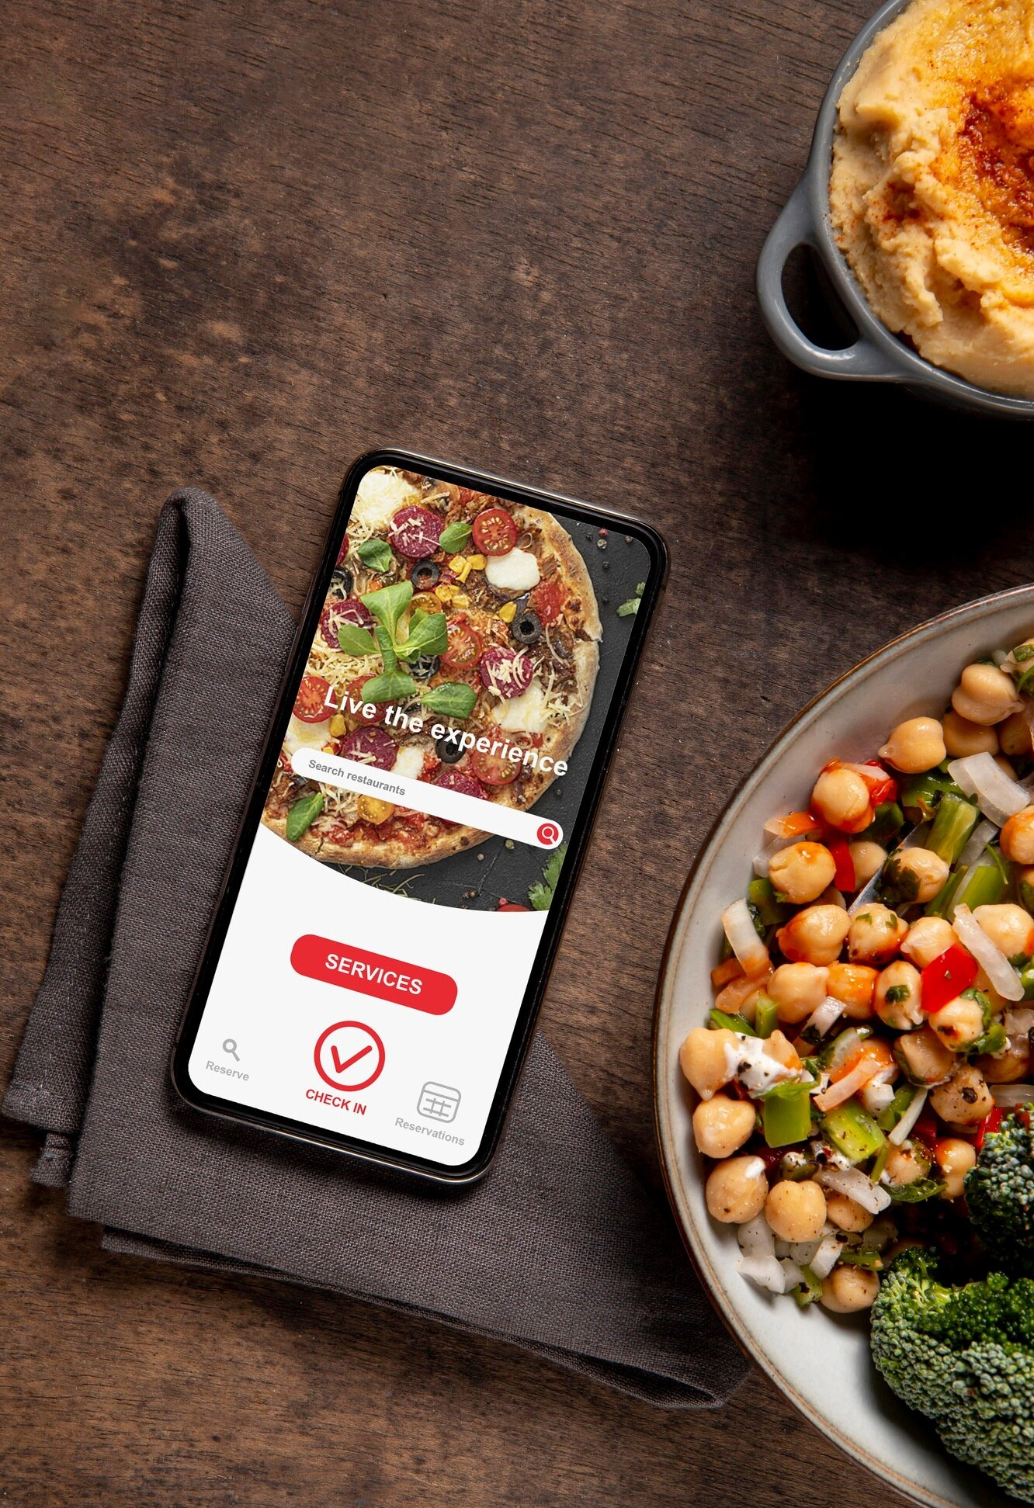



Introduction
Introducing Flutter App for food delivery revolution. Explore how this innovative platform is changing the game for both customers and businesses in the food industry.

Slide 3


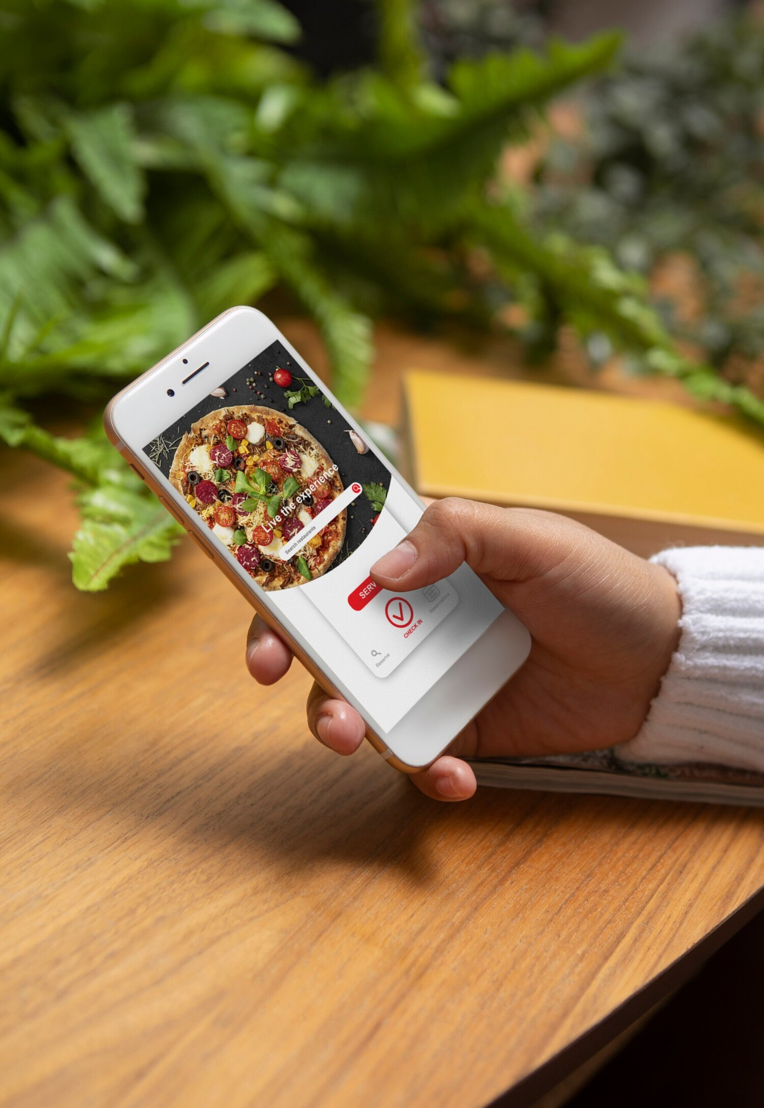

Seamless Ordering
Effortless and intuitive user interface for ordering food.
Customers can easily browse menus, customize orders, and track delivery status in real time.

Slide 4


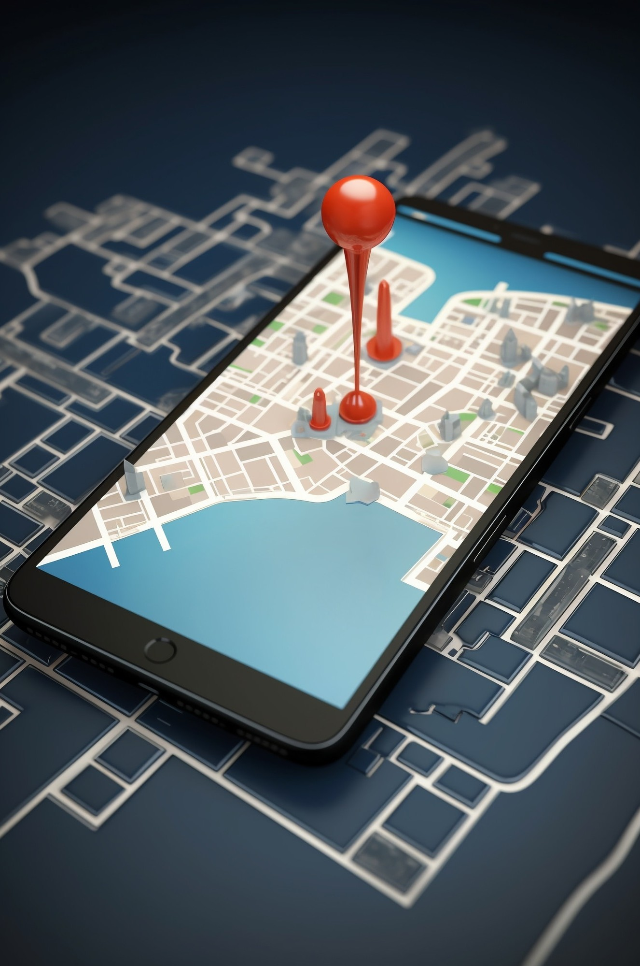

Real-time Tracking
Track your order from the moment it's placed to the minute it arrives at your doorstep. Live updates ensure customers are always informed about the status of their delivery.

Slide 5


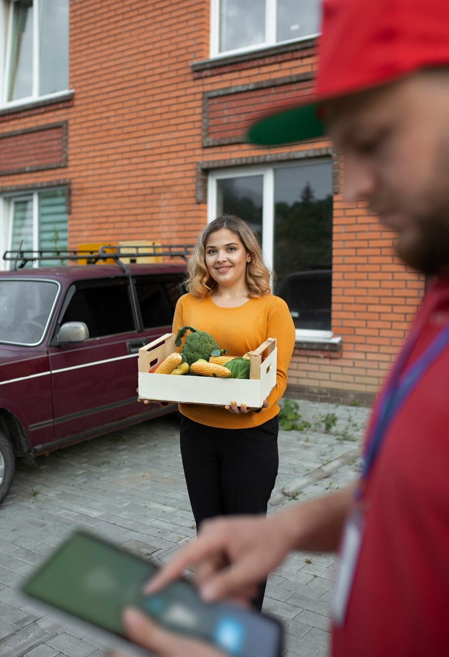



Enhanced User Experience
A seamless and enjoyable experience for both customers and delivery drivers. The app's design and features prioritize user satisfaction and convenience.

Slide 6
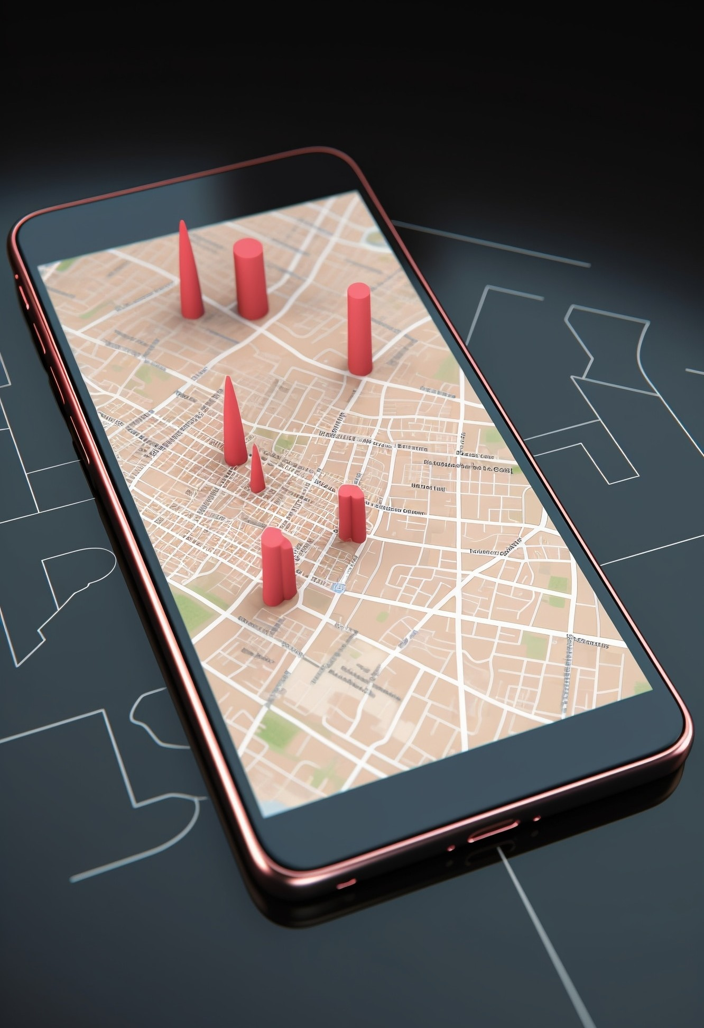

Efﬁcient Delivery Management
For businesses, the app provides streamlined tools for managing orders, assigning deliveries, and optimizing routes. This leads to faster and more efficient deliveries.

Slide 7

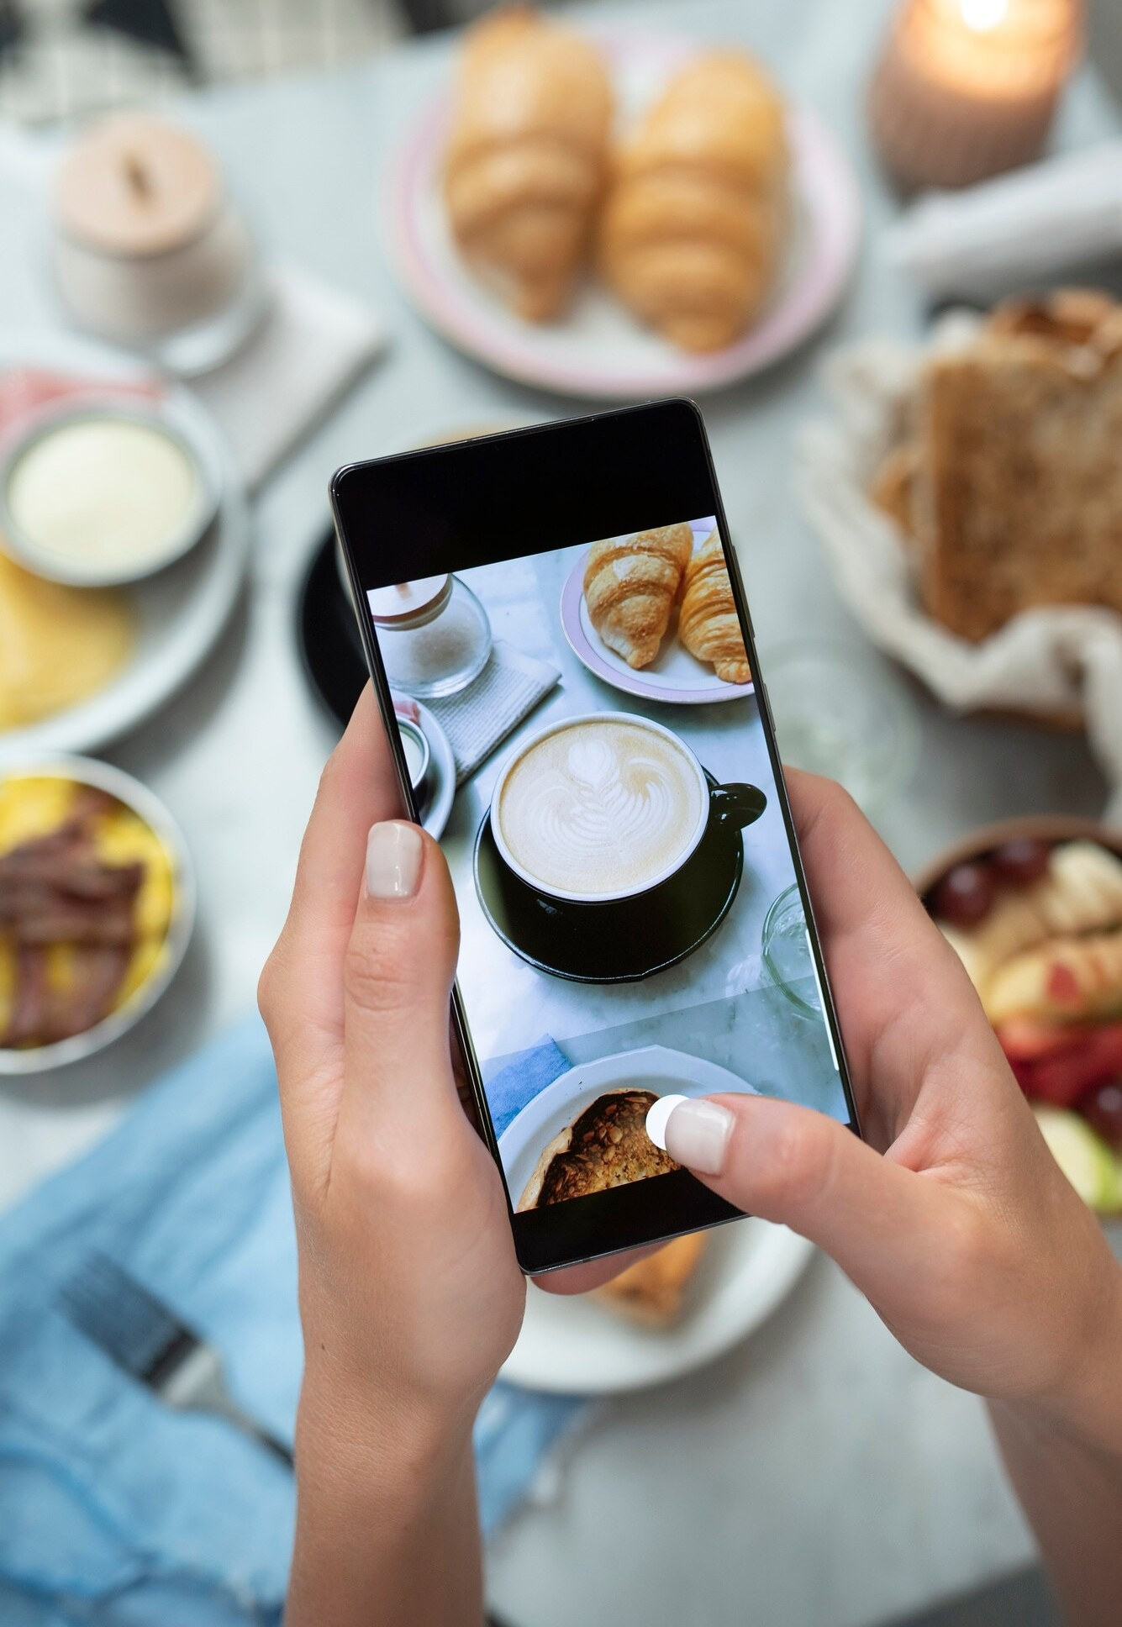


Customized Menu Recommendations
Utilizing AI algorithms, the app offers personalized menu recommendations based on user preferences and ordering history. This enhances the overall dining experience.

Slide 8


Seamless Payment Integration
Integrated secure and convenient payment options for a hassle-free checkout experience. Customers can choose from various payment methods, including digital wallets and cards.

Slide 9


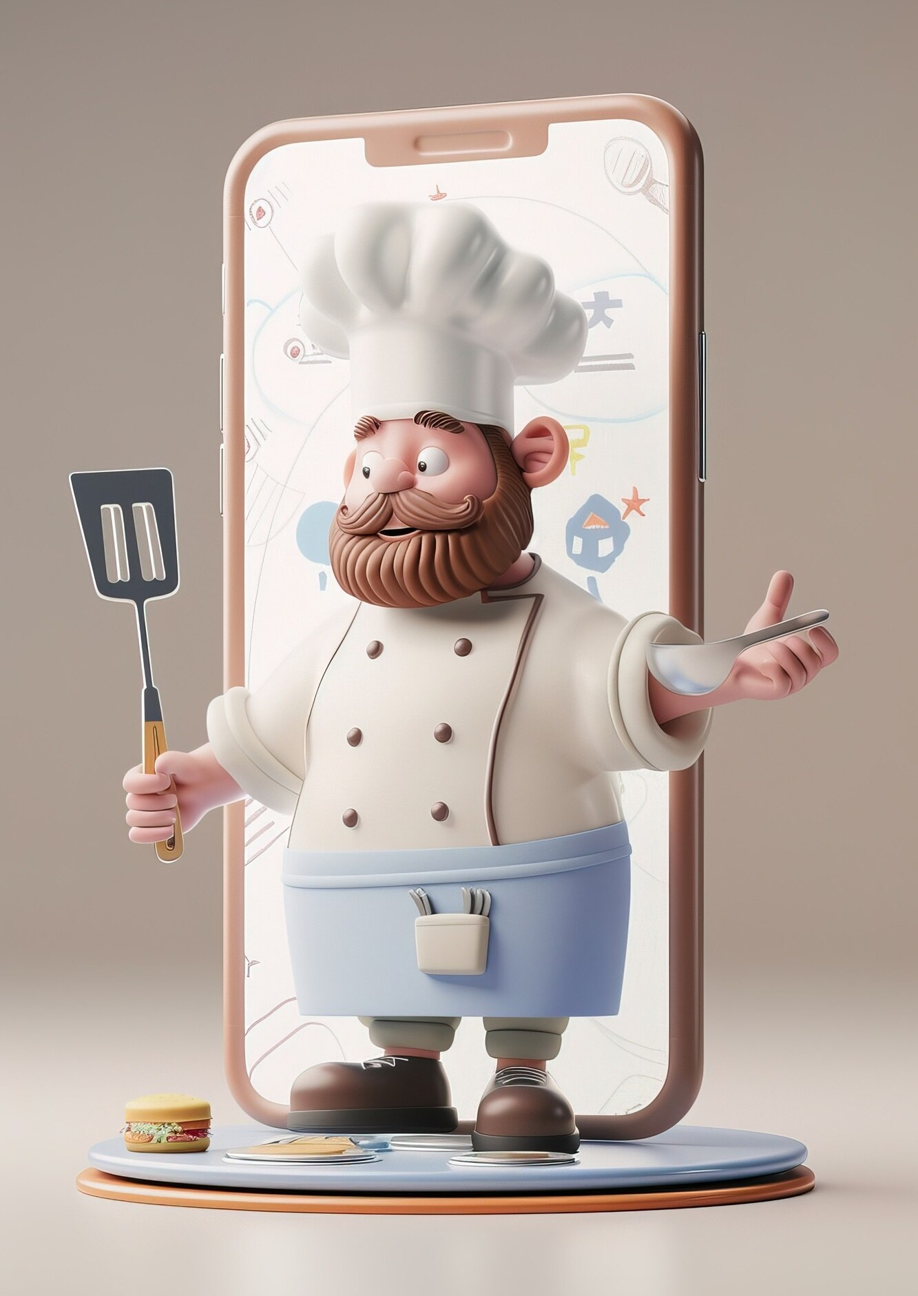


Business Growth Opportunities
The app provides restaurants and food establishments with a platform for expanding their customer base and reaching new markets, leading to increased sales and growth.

Slide 10



Customer Loyalty and Rewards
Implementing loyalty programs and reward systems to incentivize repeat orders and customer engagement. This fosters lasting relationships between businesses and their customers.

Slide 11



Conclusion
The Flutter app is revolutionizing the food delivery industry by offering a seamless, efficient, and customer-centric solution for both users and businesses. Embracing this technology is the key to success in the modern era of food delivery.

Slide 12


Thanks!

